Slide 1


CS-446: Information Systems Security
Lecture # 14: Email Security (PGP S/MIME)
Prof. Dr. Sufian Hameed
Department of Computer Science
FAST-NUCES

Slide 2
Overview
Email Security
S/MIME
PGP

Slide 3
Email Security
Email is one of the most widely used and regarded network services
Currently message contents are not secure
may be inspected either in transit
or by suitably privileged users on destination system
Notes:
In virtually all distributed environments, electronic mail is the most heavily used network-based application. But current email services are roughly like "postcards”, anyone who wants could pick it up and have a look as its in transit or sitting in the recipients mailbox.

Slide 4

Threats to E-mail
Loss of confidentiality.
E-mails are sent in clear over open networks.
E-mails stored on potentially insecure clients and mail servers.
Loss of integrity.
No integrity protection on e-mails; anybody be altered in transit or on mail server.

Slide 5
Threats to E-mail
Lack of data origin authentication.
Is this e-mail really from the person named in the From:field?
Lack of non-repudiation.
Can I rely and act on the content? (integrity)
If so, can the sender later deny having sent it? Who is liable if I have acted?

Slide 6
Threats to E-mail
Lack of notification of receipt.
Has the intended recipient received my e-mail and acted on it?
A message locally marked as ‘sent’ may not have been delivered.

Slide 7
E-mail security
Software for encrypting email messages has been widely available for more than 20 years, but the email-using public has failed to adopt secure messaging. This failure can be explained through a combination of:
technical,
community,
and usability factors

Slide 8
E-mail Security
Why Don’t People Use Email Security?
I don’t because I don’t care.
I doubt any of my usual recipients would understand
the significance of the signature.
Never had the need to send these kinds of emails.
I don’t think it’s necessary to encrypt my email.
it’s just another step & something else I don’t have time

Slide 9
Why do I want secure email ?
Protect sensitive data
Prove authenticity to recipients
Send attachments normally filtered
Avoid the junk folder!

Slide 10
How does Secure Email works ?
Secure email uses a set cryptographic tools to encapsulate a message into a specially formatted envelope.

Slide 11
Encryption
Means of hiding a message through substitution or rearranging letters
Requires a “key” to unlock the original message

Slide 12
Digital Signature
A string of characters that uniquely identifies the signer of an electronic message.
Recipients are able to
Verify message was from purported sender
Verify message was not modified in transit
Sender cannot deny being originator of message

Slide 13
Pick your poison
Most popular secure email standards
S/MIME
PGP (OpenPGP)
How are these different?
Similar services
Different trust models

Slide 14
Hierarchical Trusts
All users directly trust some central authority (CA) and the CA issue them a Digital Certificate
Alice trusts Bob if Bob’s “chain of trust” traces back to the central authority
Example: driver’s license
Issued by state authority to prove identity to others

Slide 15
Getting a Digital Certificate
Must be issued by an authority
Organizational PKI
Third-party vendor
Free personal certificates available
VeriSign
GeoTrust
Startcom
CACert
Comodo
http://www.sslshopper.com/email-certificates-smime-certificates.html

Slide 16
Web of Trust
Incorporates user perception of trust
Any user can be an authority to verify others
Users can assign levels of trust
Not all authorities are equal
“Alice and Bob think she is Carol, and that’s good enough for me.”

Slide 17


Secure e-mail
Alice wants to send confidential e-mail, m, to Bob.
K_{S}
.
K_{S}(m )
K_{S}(m )
.
m
K_{S}( )
K_{S}( )
m
+
-
Internet
K_{S}
.
.
+
-
K_{S}
K_{B}( )
+
+
K_{B}( )
K_{B}(K_{S} )
K_{B}(K_{S} )
+
-
K_{B}
K_{B}
Alice:
generates random symmetric private key, K_{S}
encrypts message with K_{S} (for efficiency)
also encrypts K_{S} with Bob’s public key
sends both K_{S}(m) and K_{B}(K_{S}) to Bob

Slide 18
Secure e-mail
Alice wants to send confidential e-mail, m, to Bob.
K_{S}
.
K_{S}(m )
K_{S}(m )
.
m
K_{S}( )
K_{S}( )
m
+
-
Internet
K_{S}
.
.
+
-
K_{S}
K_{B}( )
+
+
K_{B}( )
K_{B}(K_{S} )
K_{B}(K_{S} )
+
-
K_{B}
K_{B}
Bob:
uses his private key to decrypt and recover K_{S}
uses K_{S} to decrypt K_{S}(m) to recover m

Slide 19
Secure e-mail (continued)
Alice wants to provide sender authentication message integrity
-
+
K_{A}
K_{A}
.
.
-
-
.
-
K_{A}(H(m))
K_{A}(H(m))
+
H(m )
m
H( )
K_{A}( )
K_{A}( )
+
-
compare
Internet
.
m
H( )
H(m )
m
Alice digitally signs message
sends both message (in the clear) and digital signature

Slide 20
Secure e-mail (continued)
Alice wants to provide secrecy, sender authentication, message integrity.
-
K_{A}
.
.
-
-
K_{A}(H(m))
K_{S}
m
H( )
K_{A}( )
.
+
K_{S}( )
m
+
Internet
.
+
K_{S}
K_{B}( )
+
K_{B}(K_{S} )
+
K_{B}
Alice uses three keys: her private key, Bob’s public key, newly created symmetric key

Slide 21
S/MIME (Secure/Multipurpose Internet Mail Extension)
Originated from RSA Data Security Inc. in 1995.
Further development by IETF S/MIME working group at: www.ietf.org/html.charters/smime-charter.html.
Version 3.2 specified in RFC 5751.
Allows flexible client-client security through encryption and signatures.
Widely supported, e.g. in Microsoft Outlook, Thunderbird, Lotus Notes.

Slide 22
Understanding What S/MIME Does
S/MIME provides two security services:
Digital signatures
Message encryption
http://technet.microsoft.com/en-us/library/aa995740(v=exchg.65).aspx

Slide 23
Key Wrapping and Content Encryption in S/MIME
RSA is used as Key wrapping algorithm
Content encryption is based on session keys.
AES-128 CBC added as MUST, AES-192 and AES-256 CBC are optional

Slide 24
PGP (Pretty Good Privacy)
Open source, freely available software package for secure e-mail
De facto standard for secure email
Developed by Phil Zimmermann
Selected best available crypto algos to use
Runs on a variety of platforms like Unix, PC, Macintosh and other systems
Originally free (now also have commercial versions available)
Notes:
The Pretty Good Privacy (PGP) secure email program, is a remarkable phenomenon, has grown explosively and is now widely used. Largely the effort of a single person, Phil Zimmermann, who selected the best available crypto algorithms to use & integrated them into a single program, PGP provides a confidentiality and authentication service that can be used for electronic mail and file storage applications. It runs on a wide range of systems, in both free & commercial versions.

Slide 25

PGP (Pretty Good Privacy)
PGP is an open-source freely available software package for e-mail security. It provides authentication; confidentiality; compression; e-mail compatibility; and segmentation and reassembly.

Slide 26
PGP (Pretty Good Privacy)
PGP Algorithms
Symmetric encryption:
DES, 3DES, AES and others.
Public key encryption of session keys:
RSA or ElGamal.
Hashing:
SHA-1, MD-5 and others.
Signature:
RSA, DSS, ECDSA and others.
Notes:
Digital Signature Standard (DSS)
Elliptic Curve Digital Signature Algorithm (ECDSA)

Slide 27
Key Management and Web of Trust
PGP use:
public keys for encrypting session keys / verifying signatures.
private keys for decrypting session keys / creating signatures.
PGP adopts a trust model called the web of trust.
No centralised authority
Individuals sign one another’s public keys, these “certificates” are stored along with keys in key rings.

Slide 28
Trust Level for Public Key
PGP computes a trust level for each public key in key ring.
Users interpret trust level for themselves.
Trust levels for public keys dependent on:
Number of signatures on the key;
Trust level assigned to each of those signatures.
Trust levels recomputed from time to time.

Slide 29
PGP Key Rings
PGP Key Rings
PGP supports multiple public/private keys pairs per sender/recipient.
Keys stored locally in a PGP Key Ring – essentially a database of keys.
Private keys stored in encrypted form; decryption key determined by user-entered pass-phrase.

Slide 30
PGP Session Keys
Need a session key for each message
Varying sizes: 56-bit DES, 128-bit CAST or IDEA, 168-bit Triple-DES, 128, 192, 256 bits AES
Uses random inputs taken from
-actual keys hit
-keystroke timing of a user
Notes:
PGP makes use of four types of keys: one-time session symmetric keys, public keys, private keys, and passphrase-based symmetric keys.
Each session key is associated with a single message and is used only for the purpose of encrypting and decrypting that message. Random numbers are generated using the ANSI X12.17 generator, with inputs based on keystroke input from the user, where both the keystroke timing and the actual keys struck are used to generate a randomized stream of numbers. Stallings Appendix 15C discusses PGP random number generation techniques in more detail.

Slide 31
PGP Public & Private Keys
Since many public/private keys may be in use, need to identify which is actually used to encrypt session key in a message
Could send full public-key with every message
but this is inefficient
Rather use a key identifier based on key
is least significant 64-bits of the key
will very likely be unique
Also use key ID in signatures
Notes:
Since many public/private keys may be in use with PGP, there is a need to identify which key is actually used to encrypt the session key for any specific message. You could just send the full public-key with every message, but this is inefficient. Rather PGP use a key identifier based on the least significant 64-bits of the key, which will very likely be unique. Then only the much shorter key ID would need to be transmitted with any message. A key ID is also required for the PGP digital signature.

Slide 32
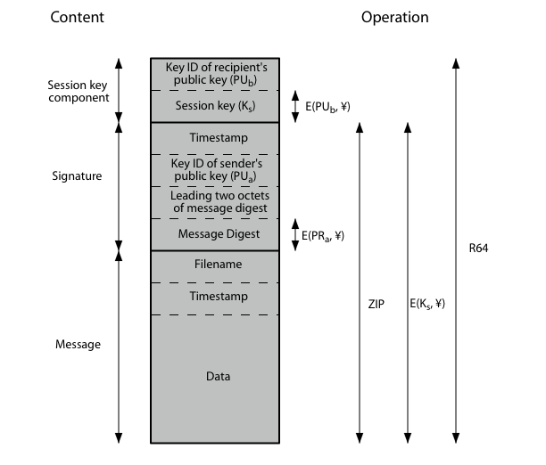
PGP Message Format
Notes:
Stallings Figure 15.3 shows the format of a transmitted PGP message. A message consists of three components: the message component, a signature (optional), and a session key component (optional).

Slide 33
PGP services
Messages
authentication
confidentiality
compression
e-mail compatibility
segmentation and reassembly
Key Management
generation, distribution, and revocation of public/private keys
generation and transport of session keys and IVs
Notes:
when using PGP will have binary data (8-bit octets) to send (encrypted message, etc)
however email was designed only for text
hence PGP must encode raw binary data into printable ASCII characters
uses radix-64 algorithm
maps 3 bytes to 4 printable chars
also appends a CRC
PGP also segments messages if too big
(maximum length 50,000 octets)

Slide 34
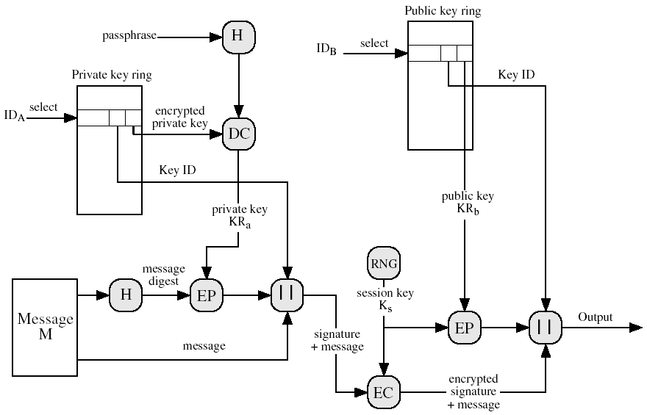
PGP Message Generation

Slide 35
PGP Message Generation
The sending PGP entity performs the following steps:
Signs the message:
PGP gets sender’s private key from key ring using its user id as an index.
PGP prompts user for passphrase to decrypt private key.
PGP constructs the signature component of the message.
Encrypts the message:
PGP generates a session key and encrypts the message.
PGP retrieves the receiver public key from the key ring using its user id as an index.
PGP constructs session component of message

Slide 36
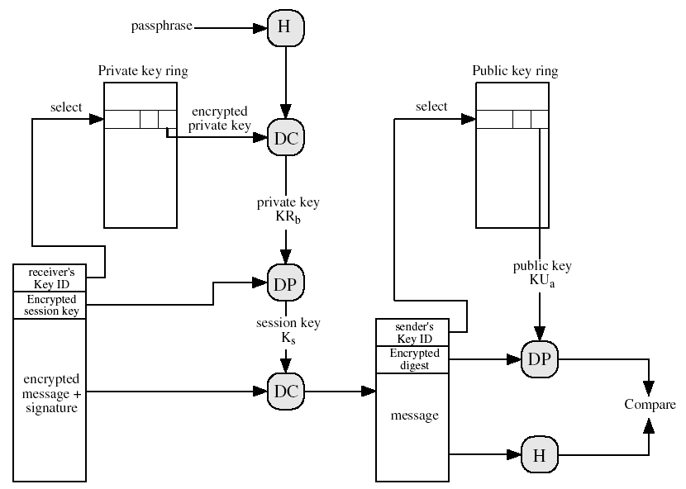
PGP Message Reception

Slide 37
PGP Message Reception
The receiving PGP entity performs the following steps:
Decrypting the message:
PGP get private key from private-key ring using Key ID field in session key component of message as an index.
PGP prompts user for passphrase to decrypt private key.
PGP recovers the session key and decrypts the message.
Authenticating the message:
PGP retrieves the sender’s public key from the public-key ring using the Key ID field in the signature key component as index.
PGP recovers the transmitted message digest.
PGP computes the message for the received message and compares it to the transmitted version for authentication.

Slide 38
Resources
http://www.pgpi.org/doc/faq/
www.gnupg.org
William Stallings,” Cryptography and Network Security Principles and Practices”, Fourth Edition ” Prentice Hall , 2005
GITA” Encryption Technologies”, Standard P800-S850 V2.0, April 5, 2004
Sieuwert van Otterloo” A security analysis of Pretty Good Privacy”, September 7, 2001
Amr el-kadi” what is computer security”2005

Slide 39
Acknowledgements
Material in this lecture are taken from the slides prepared by:
Hussain Awad and Dr. Lo’ai Tawalbeh
Lawrie Brown (University of Kentucky)
M. Singhal (University of Kentucky)
Addam Schroll (Purdue University)

